Slide 1
Digital Portfolio
STUDENT NAME: K.GIRI
REGISTER NO :20324U48008
NMLD:5B069587675515B855D469D464CE069FD
DEPARTMENT:B.SC DATA SCIENCE
COLLEGE: DR.M.G.R.CHOCKALINGAM ARTS COLLEGE
UNIVERSITY:THIRUVALLUAR UNIVESITY

Slide 2
PROJECT TITLE
It appears to be in all caps with a clean, minimalistic font, possibly used as a placeholder or template for a presentation, report, or design project.
If you'd like help creating a full title page, a report layout, or even ideas for a project title, feel free to let me know your topic or field!

Slide 3


AGENDA
Problem Statement
Project Overview
End Users
Tools and Technologies
Portfolio design and Layout
Features and Functionality
Results and Screenshots
Conclusion
Github Link
3/21/2024 Annual Review

Slide 4

PROBLEM STATEMENT
Many [target users / organizations] face challenges with [briefly describe the problem]. This issue leads to [consequences of the problem]. There is a need for a solution that can [general idea of what a solution should do].

Slide 5

PROJECT OVERVIEW
📋 Project Overview (Simple)
This project is about [what the project is]. It aims to [main goal or purpose]. The project will [briefly say what you will do or create].
Example:
This project is about creating a website for a local bakery. It aims to help the bakery reach more customers online. The project will design and build a simple, easy-to-use website.

Slide 6

WHO ARE THE END USERS?
The end users are the people who will use or benefit from the project or product. They are the main audience for whom the solution is designed.

Slide 7

TOOLS AND TECHNIQUES
This project will use the following tools and techniques:
Tools: [List software, hardware, equipment, platforms, etc.]
Techniques: [List methods, processes, approaches, or frameworks you will apply]

Slide 8
POTFOLIO DESIGN AND LAYOUT
Simple Portfolio Layout
1. Cover Page / Introduction
Your Name
Title (e.g., Designer, Developer)
Contact Info (email, website, phone)
2. About Me
Short bio or personal statement
3. Skills
List of key skills or expertise areas
4. Projects
Project Title
Description
Tools/Technologies used
Images or screenshots (if any)
5. Experience (Optional)
Brief work history or internships
6. Contact
How to get in touchSimple Portfolio Layout
.
8

Slide 9
FEATURES AND FUNCTIONALITY
Would you like me to help you draft a simple list of features and functionalities for your project? Just share what your project is about or some key features you want to include!

Slide 10
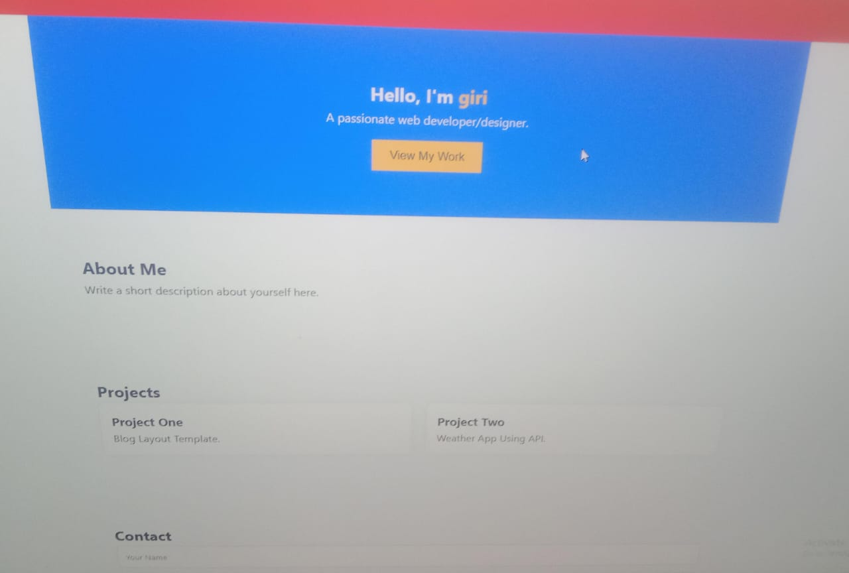
RESULTS AND SCREENSHOTS
3/21/2024 Annual Review
10

Slide 11
CONCLUSION
In conclusion, this project [summarize the main goal or outcome]. The project successfully [mention key achievements or results]. It addresses the problem by [briefly restate how the problem was solved]. Future work may include [optional: mention possible improvements or next steps].
11

Slide 12
GITHUB LINK
t
https://github.com/giri20324u48008-create/digital-protfolio-.git
OUTPUT LINK
https://giri20324u48008-create.github.io/digital-protfolio-/

